Slide 1

Building Modern Systems: Theory and Implementation (Computational Intelligence)
Hamas ur Rehman

Slide 2
Course Contents
Module 1: Advanced AI Systems
Module 2: Generative AI and Large Language Models (LLMs)
Module 3: APIs – Theory and Practical Implementation
Module 4: Building a Chatbot with LLMs
Module 5: Logging in Applications
Module 6: Environment Variables and Secrets Management
Module 7: Storing Chats in MongoDB
Module 8: Vector Databases and ChromaDB
Module 9: Local Server Setup and Hosting APIs
Module 10: Docker for Modern Applications
Module 11: Version Control with Git
Module 12: API Testing with PyTest and Postman
Module 13: Cloud Deployment with Azure

Slide 3
Course Overview
Purpose:
To understand the design and development of advanced computational systems.
Bridge the gap between theoretical concepts and practical applications.
Key Topics:
Advanced AI Systems
Generative AI and Large Language Models
APIs and Their Implementation
Building Intelligent Applications
Modern Development Tools and Practices
Outcome:
Equip students with the skills to build intelligent, scalable, and efficient systems.

Slide 4
Lecture Overview
In this first lecture of Module 1: Advanced AI Systems, we will cover the fundamental theoretical concepts that form the backbone of modern artificial intelligence (AI) systems. This session focuses solely on theory, providing a solid foundation for understanding advanced AI technologies and their applications.

Slide 5
Learning Objectives
By the end of this lecture, students will be able to:
Define and explain what constitutes an advanced AI system.
Identify and describe various AI technologies and their applications.
Understand the historical evolution of AI systems.
Recognize current trends and anticipate future directions in AI.

Slide 6

What is Computational Intelligence?

Slide 7

What is Computational Intelligence?
Computational Intelligence (CI) is a subfield of artificial intelligence that focuses on the development of adaptive and intelligent computational systems. It encompasses techniques such as machine learning, neural networks, fuzzy systems, and evolutionary computation. CI aims to create systems that can learn from data, adapt to new situations, and make informed decisions, thereby enabling the creation of modern, intelligent systems.

Slide 8

Why "Building Modern Systems: Theory and Implementation"?
The course title emphasizes a comprehensive approach to system development. "Building Modern Systems" highlights the focus on creating advanced, scalable, and efficient computational systems. "Theory and Implementation" signifies the dual emphasis on understanding the foundational theoretical concepts and applying them through practical, hands-on projects. This combination ensures that students not only grasp the underlying principles of computational intelligence but also acquire the skills to implement these concepts in real-world applications.

Slide 9
Introduction to Advanced AI Systems

Slide 10




What are Advanced AI Systems
Advanced AI Systems refer to sophisticated artificial intelligence frameworks that exhibit higher levels of
Autonomy
Adaptability
Learning capabilities
Decision-making processes
Notes:
Advanced AI Systems are sophisticated artificial intelligence frameworks designed to mimic and often surpass certain aspects of human cognitive abilities. These systems stand out due to their ability to function with minimal human intervention and to adapt, learn, and make decisions in complex, dynamic environments

Slide 11
Autonomy
Autonomy refers to the ability of AI systems to operate independently, without continuous human intervention or supervision. In the context of advanced AI systems, autonomy is the degree to which an AI can perform tasks, make decisions, and pursue goals on its own, while adapting to real-world complexities.

Slide 12
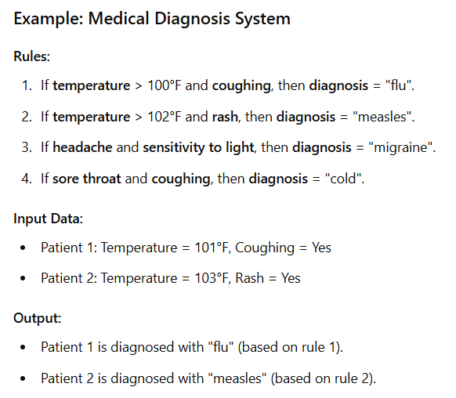
Levels of Autonomy
Low Autonomy: The system requires constant supervision and intervention.
Examples include basic automation tools like rule-based systems or early expert systems, where the AI follows pre-programmed rules.

Slide 13
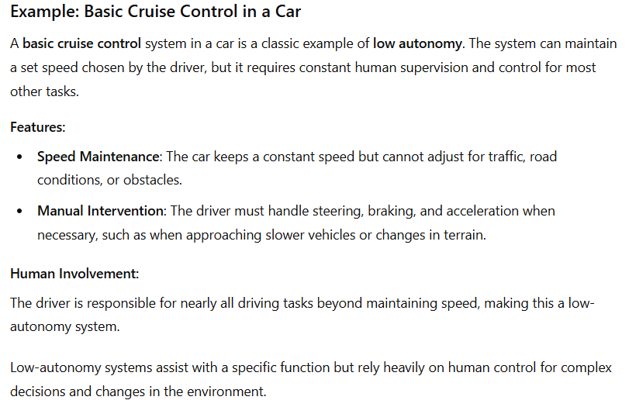

Levels of Autonomy - Low

Slide 14

Levels of Autonomy
Medium Autonomy: The system can perform tasks independently for a period but requires occasional human oversight.
For example, self-driving cars may operate independently in good conditions but need human intervention in certain complex or unusual scenarios.

Slide 15
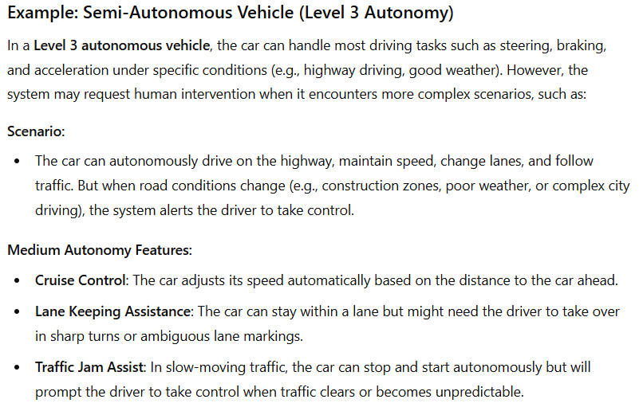
Levels of Autonomy - Medium
*What is Level 3 Autonomy?
Defined by the SAE (Society of Automotive Engineers), Level 3 autonomy allows a vehicle to handle most driving tasks independently but requires human intervention in complex situations. For instance, a Level 3 car can navigate highways but asks the driver to take over in road construction or bad weather. It’s the middle ground between driver assistance and full automation!

Slide 16

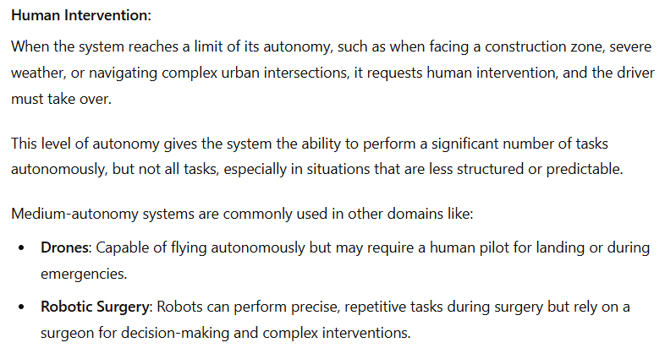

Levels of Autonomy - Medium

Slide 17

Levels of Autonomy
High Autonomy: The system can function entirely independently and handle unforeseen situations.
Examples include certain advanced military drones or autonomous trading algorithms that operate 24/7 without human involvement.

Slide 18
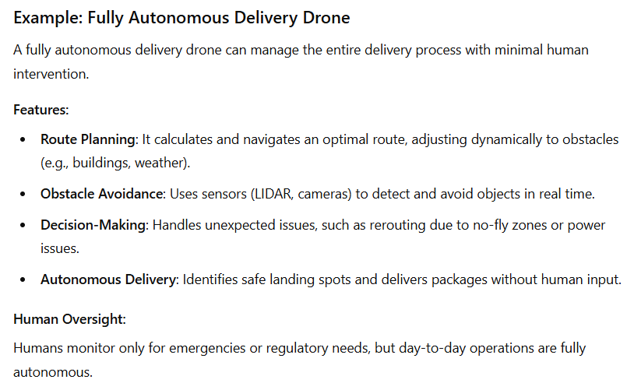

Levels of Autonomy - High

Slide 19
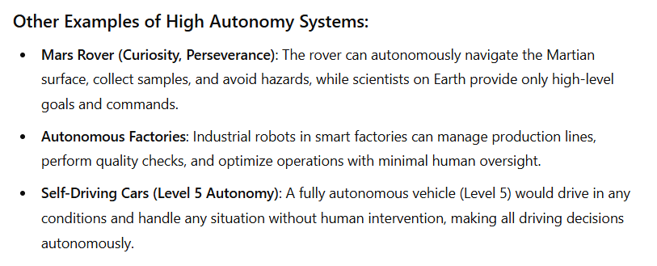
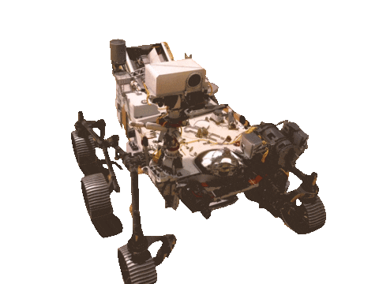
Levels of Autonomy - High

Slide 20

Challenges of Autonomy
Trust and Safety: Ensuring the system makes safe decisions in unpredictable environments.
Ethics: Autonomous systems must be programmed with ethical considerations, particularly in life-and-death situations (e.g., autonomous vehicles).
Legal Frameworks: There are often legal and regulatory challenges in allowing highly autonomous systems to operate, particularly when accountability becomes ambiguous.

Slide 21
Adaptability
Adaptability is the ability of an AI system to modify its behavior based on changes in its environment, goals, or feedback. Unlike traditional AI systems that follow static instructions, adaptable systems dynamically adjust to new data, environments, or objectives.

Slide 22

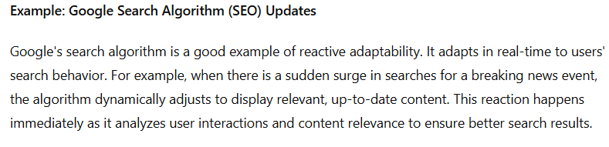
Types of Adaptability
Reactive Adaptability: The AI adapts based on immediate feedback. For instance, a trading algorithm might change its investment strategy in response to market fluctuations.

Slide 23
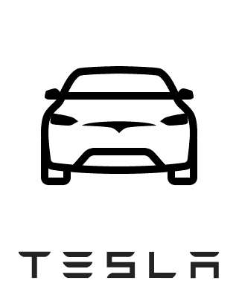
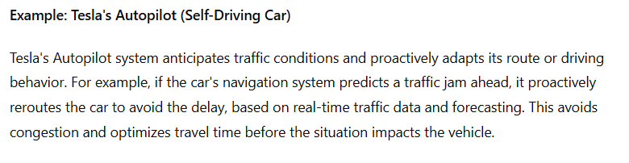
Types of Adaptability
Proactive Adaptability: The AI anticipates future changes or challenges and adapts in advance. For example, a self-driving car may anticipate a traffic jam and choose an alternate route before the jam occurs.

Slide 24
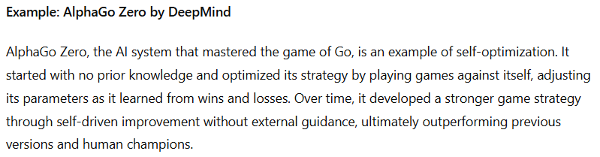
Types of Adaptability
Self-Optimization: Advanced systems can also optimize their own parameters without external guidance. This could involve tuning hyperparameters in machine learning models based on performance feedback.

Slide 25
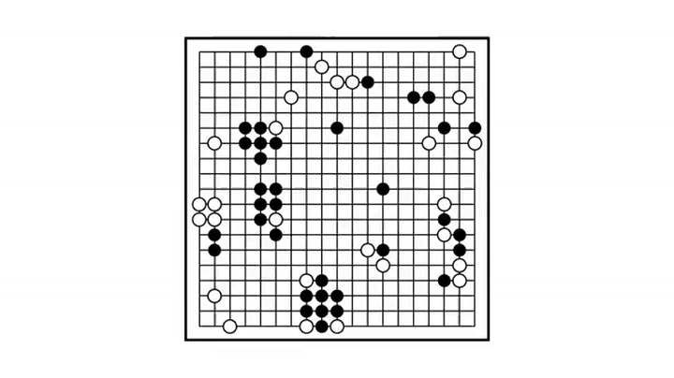

Slide 26
Challenges of Adaptability
Environment Complexity: Real-world environments are often highly dynamic and unpredictable, making adaptability a difficult challenge.
Generalization: AI systems must not only adapt to the specific situation but generalize their learning to broader circumstances.
Overfitting vs. Underfitting: While adapting to new environments, AI systems must avoid overfitting to specific scenarios at the cost of broader applicability.

Slide 27
Learning Capabilities
Learning capabilities refer to an AI system's ability to improve its performance over time by learning from data, experiences, and interactions. These capabilities allow systems to go beyond static rule-based behaviors and continuously evolve based on exposure to new data or feedback.

Slide 28
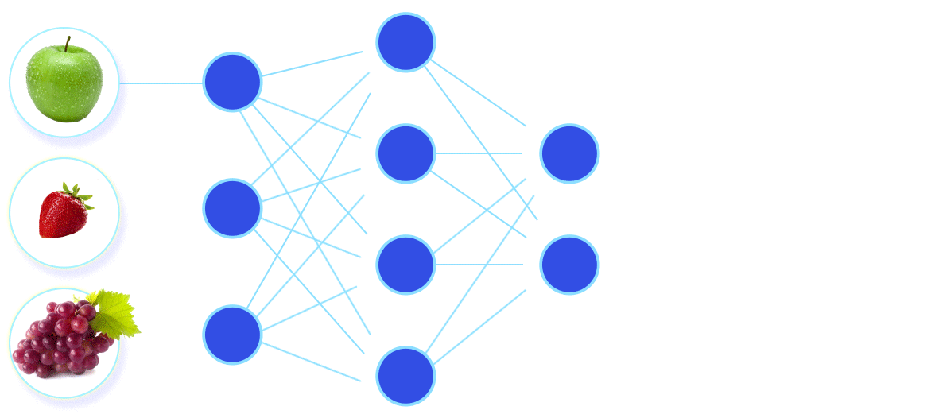
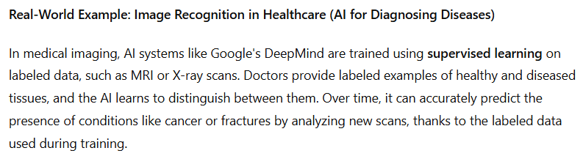
Types of Learning
Supervised Learning: The AI learns from labeled data where the desired output is provided. This form of learning requires significant human intervention for labeling but provides high accuracy.

Slide 29
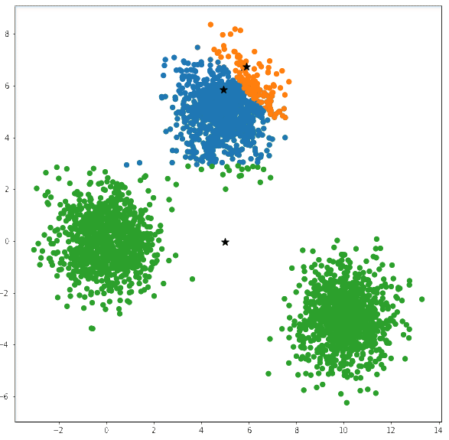
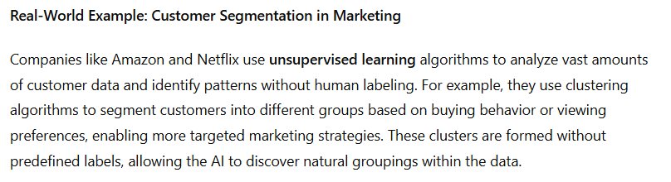
Types of Learning
Unsupervised Learning: The AI system discovers patterns and structures in unlabeled data without human intervention, such as clustering algorithms or generative models.

Slide 30
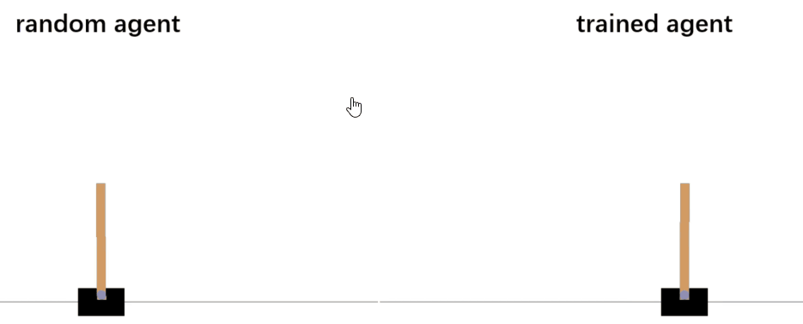
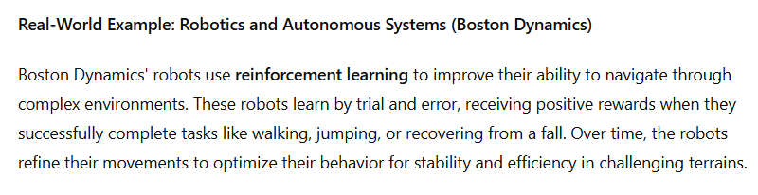
Types of Learning
Reinforcement Learning: The AI learns by trial and error, receiving rewards or penalties for actions taken in an environment. Over time, it optimizes its behavior to maximize cumulative reward.

Slide 31
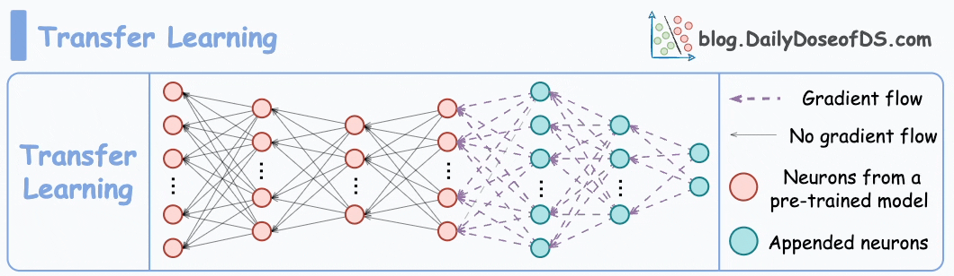
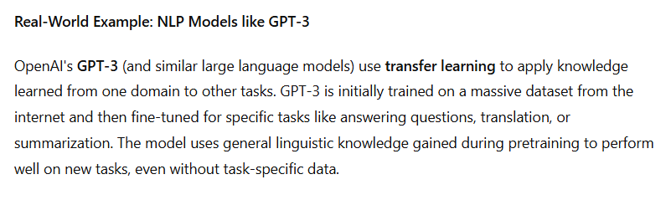
Types of Learning
Transfer Learning: The system applies knowledge gained from one domain to a different, but related, domain, enabling it to solve new problems more quickly.

Slide 32
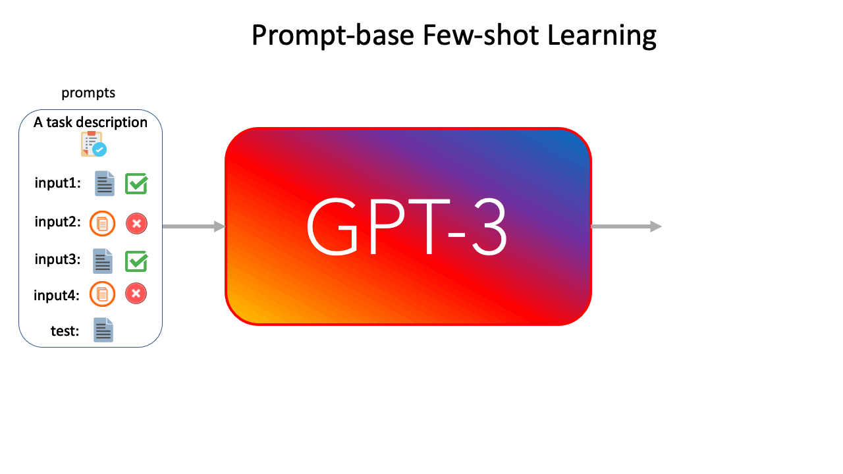
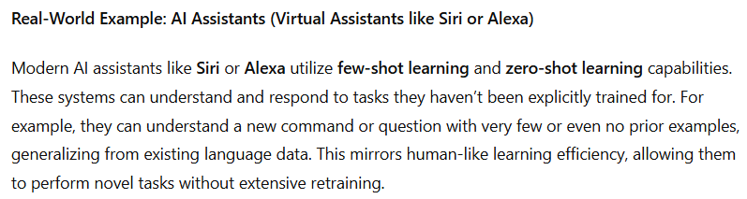
Types of Learning
Few-Shot Learning/Zero-Shot Learning: Advanced models can generalize from very few examples or even solve tasks without specific training on those tasks, mimicking human learning efficiency.

Slide 33
Challenges of Learning
Data Quality and Availability: Learning systems require vast amounts of high-quality data, which may not always be available.
Bias in Learning: AI systems can inherit biases from their training data, which may result in unfair or unethical outcomes.
Catastrophic Forgetting: When retraining on new data, some AI systems lose the knowledge they previously acquired, which poses a problem in continually learning environments.

Slide 34
Decision-Making Processes
Decision-making in AI refers to the process by which systems choose the most appropriate actions or solutions based on available information, predicted outcomes, and a set of objectives. In advanced AI systems, decision-making is often probabilistic, multi-faceted, and involves high levels of complexity.

Slide 35

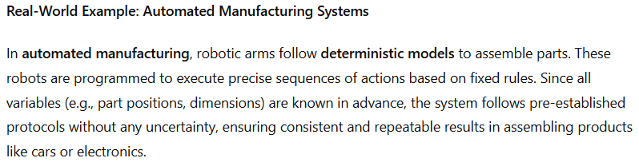
Types of Decision-Making Models
Deterministic Models: These models follow a fixed set of rules or algorithms, which are ideal for situations where all variables are known, and the system only needs to follow pre-established protocols.

Slide 36

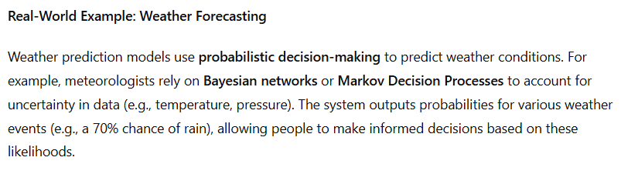
Types of Decision-Making Models
Probabilistic Models: In scenarios with uncertainty, probabilistic models (like Bayesian networks or Markov Decision Processes) are used to make decisions based on the likelihood of various outcomes.

Slide 37

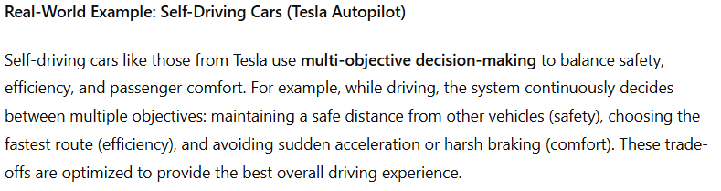
Types of Decision-Making Models
Multi-Objective Decision Making: Many advanced systems must make trade-offs between competing objectives. For instance, in a self-driving car, the system must balance safety, efficiency, and passenger comfort.

Slide 38

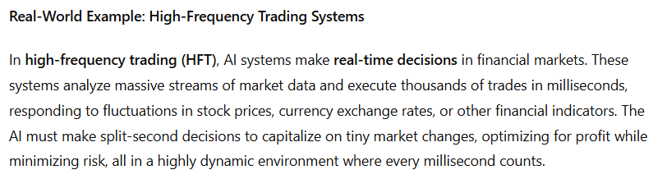
Types of Decision-Making Models
Real-Time Decision Making: Some AI systems must make decisions in real-time, often in life-critical applications. Examples include autonomous drones in military applications or AI-driven medical devices in surgery.

Slide 39
Challenges of Decision-Making
Computational Complexity: Making decisions in real-time, especially in complex environments with many variables, can be computationally expensive.
Ambiguity and Uncertainty: Many real-world environments are fraught with incomplete or ambiguous data, making it difficult for AI to make optimal decisions.
Ethical Decision Making: AI systems need to incorporate ethical considerations, particularly in situations like medical decisions or autonomous driving, where decisions can affect human lives.

Slide 40

Distinguish Advanced AI from Basic AI Systems

Slide 41
Overview of AI Technologies and Applications

Slide 42
Core AI Technologies
Machine Learning (ML)
Neural Networks and Deep Learning
Natural Language Processing (NLP)
Computer vision
Robotics

Slide 43
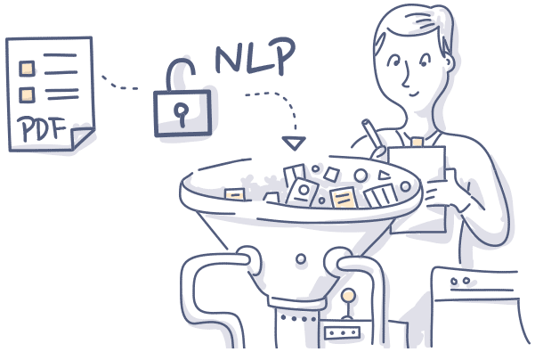
Natural Language Processing (NLP)
A field of AI that focuses on the interaction between computers and humans through natural language.
Components:
Text Processing: Tokenization, stemming, lemmatization.
Language Understanding: Parsing, sentiment analysis, entity recognition.
Language Generation: Text generation, machine translation, summarization.
Use Case Examples:
Chatbots and Virtual Assistants, Language Translation, Sentiment Analysis

Slide 44

Modern NLP
Modern NLP has been revolutionized by transformer models, such as GPT and BERT, which excel in understanding context and generating human-like text. These models use self-attention mechanisms to process language more efficiently than previous architectures. Beyond transformers, research is exploring even more efficient models for better language understanding and generation.
Transformers , BERT, GPT, RoBERTa, T5, XLNet

Slide 45
Evolution of AI Systems

Slide 46
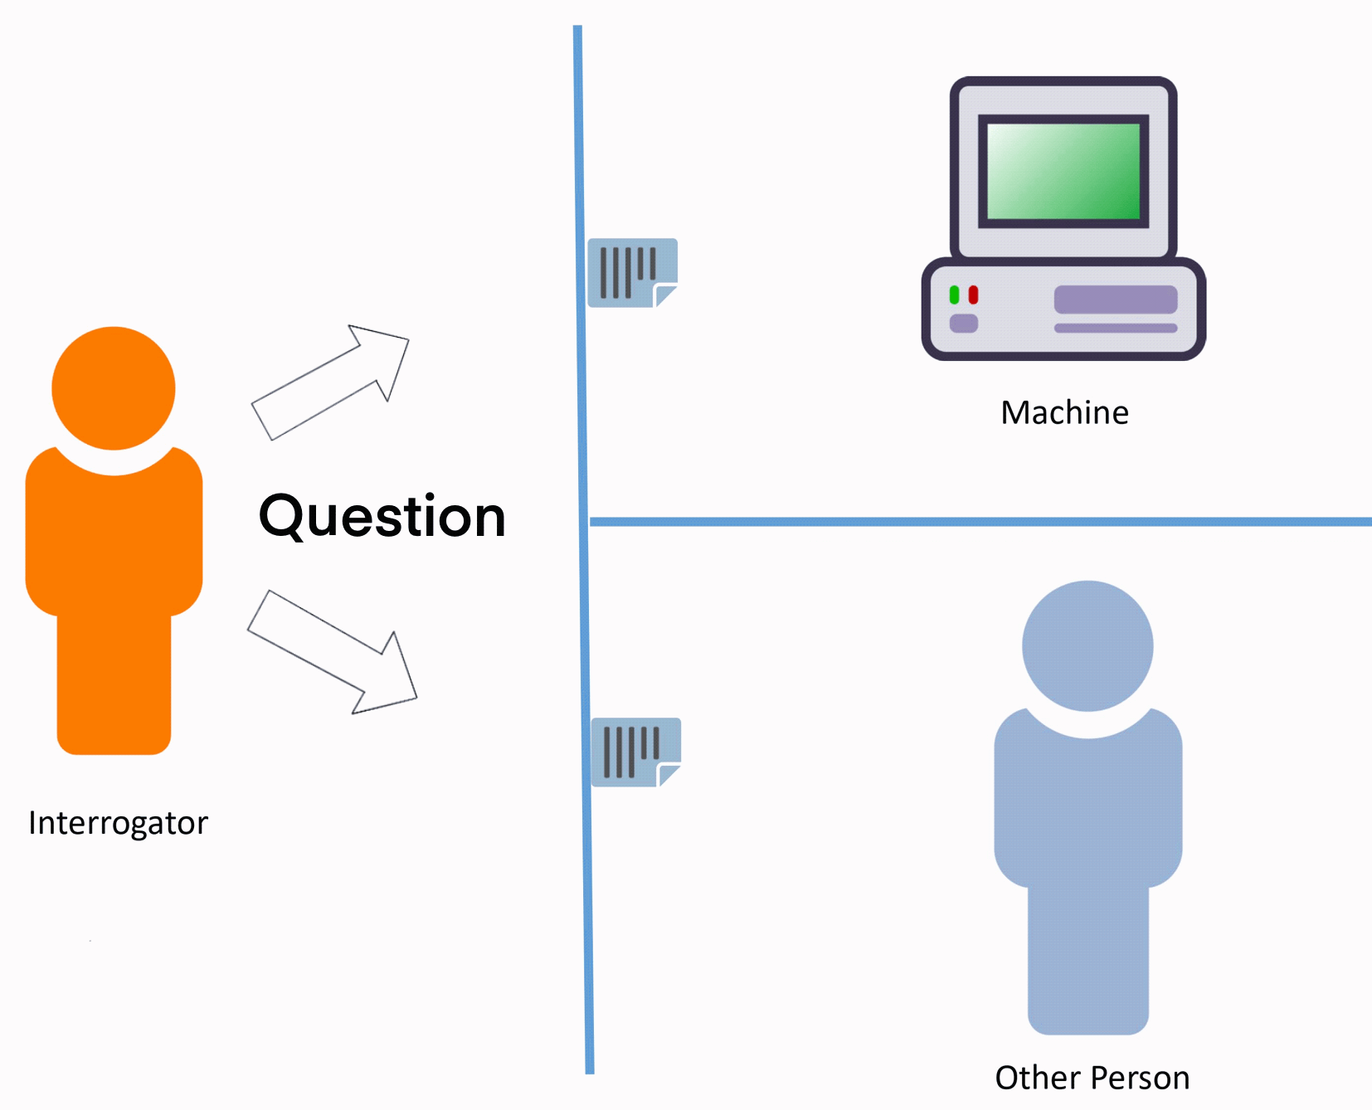
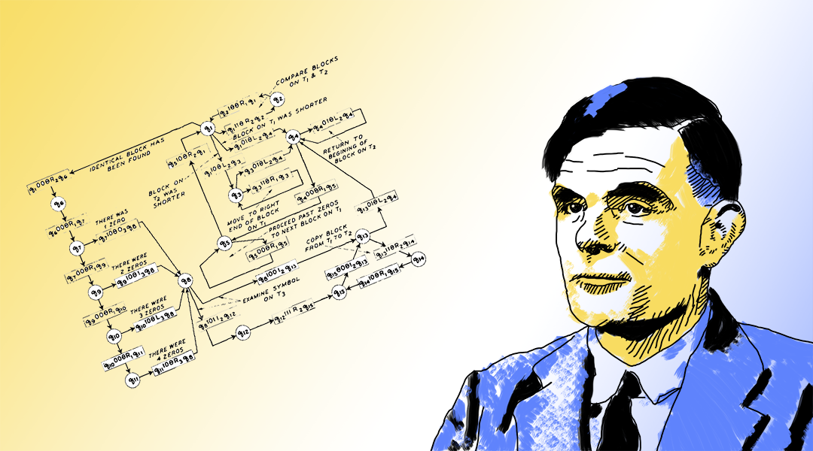
Historical Milestones - Foundational Theories
Alan Turing
Proposed the concept of a universal machine (Turing Machine) capable of performing any computation. Introduced the Turing Test as a measure of machine intelligence.
Notes:
The Turing Test, proposed by Alan Turing in 1950, evaluates whether a machine can exhibit human-like intelligence.
How It Works:
A human judge converses with both a machine and a human via text.
If the judge cannot tell which is the machine, the machine passes the test, suggesting it can mimic human conversation convincingly.
Key Points:
The test focuses on how well a machine can generate natural language responses.
Passing the test doesn’t mean the machine truly "thinks," just that it can imitate human responses.
In modern AI, passing the Turing Test is not considered a definitive measure of true intelligence, as AI systems can mimic human-like text without genuine understanding.

Slide 47

Historical Milestones - Foundational Theories
John McCarthy
Coined the term "Artificial Intelligence" in 1956.Organized the Dartmouth Conference, the first AI conference, which laid the groundwork for AI research.
Notes:
The Turing Test, proposed by Alan Turing in 1950, evaluates whether a machine can exhibit human-like intelligence.
How It Works:
A human judge converses with both a machine and a human via text.
If the judge cannot tell which is the machine, the machine passes the test, suggesting it can mimic human conversation convincingly.
Key Points:
The test focuses on how well a machine can generate natural language responses.
Passing the test doesn’t mean the machine truly "thinks," just that it can imitate human responses.
In modern AI, passing the Turing Test is not considered a definitive measure of true intelligence, as AI systems can mimic human-like text without genuine understanding.

Slide 48
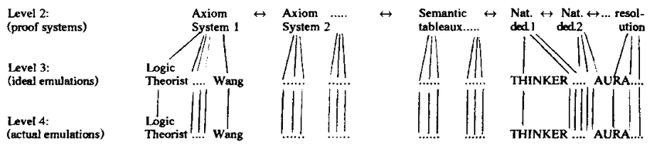
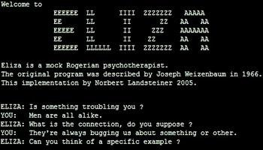
Historical Milestones - Pioneering Projects
Logic Theorist (1956)
Developed by Allen Newell and Herbert A. Simon. Considered the first AI program, capable of proving mathematical theorems.
ELIZA (1966)
Created by Joseph Weizenbaum. Early natural language processing program that simulated conversation.
Notes:
The Turing Test, proposed by Alan Turing in 1950, evaluates whether a machine can exhibit human-like intelligence.
How It Works:
A human judge converses with both a machine and a human via text.
If the judge cannot tell which is the machine, the machine passes the test, suggesting it can mimic human conversation convincingly.
Key Points:
The test focuses on how well a machine can generate natural language responses.
Passing the test doesn’t mean the machine truly "thinks," just that it can imitate human responses.
In modern AI, passing the Turing Test is not considered a definitive measure of true intelligence, as AI systems can mimic human-like text without genuine understanding.

Slide 49
Recent Advancements - Impact of Big Data and Improved Algorithms
Deep Learning Evolution
Early Models:
Simple feedforward neural networks with limited depth.
Modern Architectures:
Convolutional Neural Networks (CNNs)
Specialized for processing grid-like data such as images. Image and video recognition, object detection.
Recurrent Neural Networks (RNNs) and LSTMs
Designed for sequential data processing. Language modeling, speech recognition, time-series prediction.
Transformers
Utilizes self-attention mechanisms for parallel processing. Machine translation, text generation, and more.

Slide 50
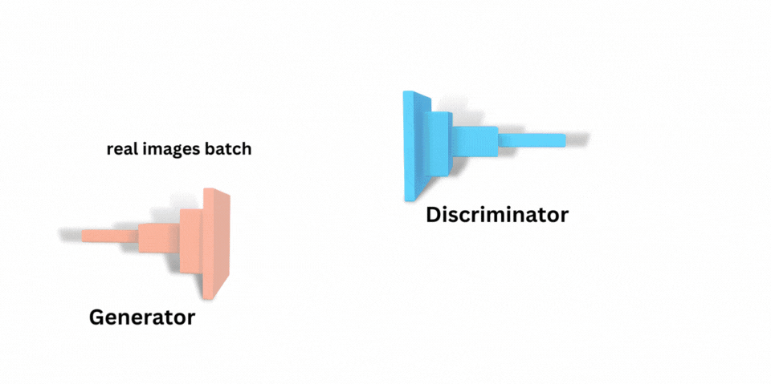
Notable Breakthroughs
ResNet (2015)
Introduced residual connections to enable training of very deep networks. Achieved state-of-the-art performance in image recognition tasks.
Generative Adversarial Networks (GANs):
Framework involving two networks (generator and discriminator) competing against each other. Applications: Image generation, style transfer, data augmentation.
Attention Mechanisms:
Enhanced the ability of models to focus on relevant parts of the input data. Key to the success of Transformer-based models like BERT and GPT.

Slide 51
Current Trends and Future Directions

Slide 52
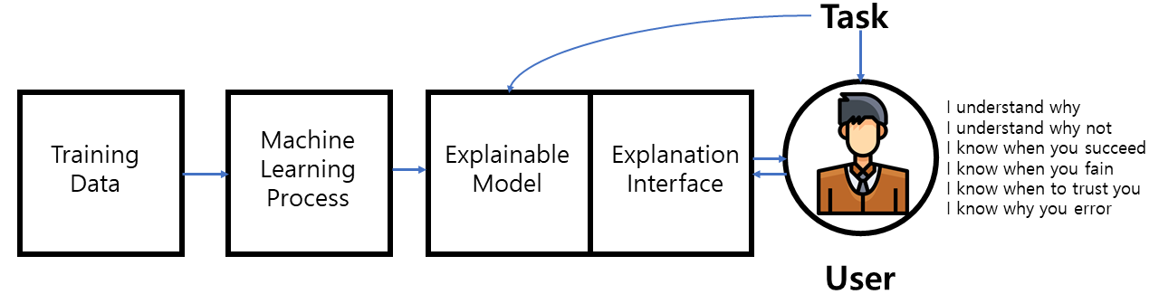
Explainable AI (XAI)
Explainable AI (XAI) focuses on making AI decision-making processes transparent and understandable to users.
Importance of Transparency
Building Trust: When users can understand how AI makes decisions, they are more likely to trust and adopt AI solutions.
Accountability & Compliance: Transparent AI ensures that systems meet legal and ethical standards, making it easier to hold entities accountable for AI-driven outcomes.
Reliability & Ethics: Explainability improves the reliability of AI by identifying biases or errors, leading to more ethical and responsible AI deployment.

Slide 53
AI Ethics and Governance
Addressing Biases in AI Systems
Identifying and Mitigating Biases: Detecting biases in data and algorithms to promote fairness and reduce discrimination in AI outcomes.
Implementing Ethical Guidelines: Establishing clear ethical standards to ensure AI is used responsibly and in alignment with societal values.
Governance Frameworks: Developing structures to monitor and regulate AI practices, ensuring accountability and compliance with ethical principles.
Identifying Biases
Mitigating Biases
Ethical Governance Integration

Slide 54

Integration with Emerging Technologies
Internet of Things (IoT): Enhancing Connectivity and Data Collection
Real-Time Data Acquisition: Gathers data from interconnected devices in real time.
Smarter AI Applications: Utilizes continuous data streams to enhance AI capabilities.
Automation & Efficiency: Improves automation across industries with enriched data.
Edge Computing: Processing Data Closer to the Source for Faster Decision-Making
Reduced Latency: Processes data locally, reducing delays compared to centralized cloud servers.
Enhanced Privacy: Maintains data security by processing sensitive information on local devices.
Real-Time Applications: Supports AI systems that need immediate decision-making responses.

Slide 55

Future Directions in AI Systems
AI-Driven Personalization and Customization:
Tailoring AI systems to individual user preferences and behaviors.
Enhancing user experiences through customized interactions and services.
Driving efficiency and satisfaction with personalized solutions.
Advances in General AI and Autonomous Systems:
Moving towards Artificial General Intelligence (AGI) with versatile cognitive abilities.
Developing autonomous systems capable of independent decision-making.
Addressing challenges in complexity, ethics, and safety for reliable AI operations.

Slide 56

Future Directions in AI Systems
Sustainable and Energy-Efficient AI Solutions:
Reducing the environmental impact of large-scale AI models.
Implementing green computing practices and optimizing algorithms for efficiency.
Promoting sustainable AI development to ensure long-term viability.

Slide 57

What’s Next?
Generative AI and Large Language Models (LLMs)

Slide 58


